Slide 1
School District No 50 (Haida Gwaii)
Draft Preliminary Budget
2014/15

Slide 2
Draft Budget presentation
Enrollment
Revenue – SD 50 is into Funding Protection and in decline
Staffing
Draft Budget Considerations and Possibilities
Discussions about Possible Future Directions

Slide 3
School District 50 Enrolment

Slide 4
Enrolment by grade 2014/15

Slide 5
Enrolment by school
FOR 2014/15 (Feb 2014 Projection)
 |  |  |  |  |  |  |  |  |  |  |  |  |  |  | Total | FTE | Adult | FTE
 | K | 1 | 2 | 3 | 4 | 5 | 6 | 7 | 8 | 9 | 10 | 11 | 12 | Ungraded |  | Students | Students
Agnes L Mathers Elem -Secondary | 5 | 5 | 3 | 3 | 6 | 2 | 5 | 3 | 3 | 2 | 2 | 4 | 2 | 0 | 45.000 | 44.000 | 15.000 | 59.000
Queen Charlotte Secondary | 0 | 0 | 0 | 0 | 0 | 0 | 0 | 0 | 16 | 40 | 26 | 31 | 28 | 0 | 141.000 | 138.500 | 0.000 | 138.500
Port Clements Elementary | 5 | 4 | 4 | 5 | 4 | 7 | 8 | 4 | 0 | 0 | 0 | 0 | 0 | 0 | 43.000 | 43.000 | 0.000 | 43.000
Sk'aadgaa Naay Elementary School | 14 | 16 | 14 | 21 | 17 | 22 | 27 | 18 | 0 | 0 | 0 | 0 | 0 | 0 | 149.000 | 149.000 | 0.000 | 149.000
Tahyghen Elementary School | 5 | 6 | 5 | 4 | 5 | 17 | 15 | 16 | 0 | 0 | 0 | 0 | 0 | 0 | 73.000 | 73.000 | 0.000 | 73.000
George Dawson Secondary School | 0 | 0 | 0 | 0 | 0 | 0 | 0 | 0 | 22 | 16 | 20 | 23 | 20 | 0 | 101.000 | 101.000 | 0.000 | 101.000
TOTAL | 29 | 31 | 26 | 33 | 32 | 48 | 55 | 41 | 41 | 58 | 48 | 58 | 50 | 0 | 552.000 | 548.500 | 15.000 | 563.500

Slide 6
Provincial funding

Slide 7
Province wide
Provincial Education Funding the same, at $4.725 Billion, or 27 cents of every tax dollar
Decline of 7000 FTE students, slightly more than last year
Funding per FTE remains the same at $6,900
LIF, Early Reader Funds to continue
AFG to continue
14 districts reporting stable or increased enrolment, 30 districts in Funding Protection.
No increase to cover rise in pensions, bargaining ongoing

Slide 8
Haida Gwaii
As our drop would equate to more than 1.5% of our budget, we are in Funding Protection ($81 000), thus a cut of $53 000.
Block Grant for SD 50 will be $10 013 777.
With additional cost pressures and new initiatives we will need to calculate on saving approximately $250 000

Slide 9
Considerations
Gradual increase in costs
Contingency if we need to pay for raises
Legal matters
Need to cover revisions to Collective Agreement requirements
AFG considerations-Planning for Sandspit and Masset
$20 000 for SIS changeover
Possible future changes in funding formula – funding protection, etc.
Total $200 000-300 000

Slide 10
Provincial Funding 2014/15
Provincial Grants | Dollars
Base Allocation | $3,784,650
Enrollment Decline | $84, 225
Unique Student Needs | $1,197,390
Salary Differential | $153, 960
Unique Geographic Factors | $4,700,336
Funding Protection | $81,890
Funding Education Plan | $12,443
Total | $10, 013,777

Slide 11
School District Funding 2014 some approximations
Total Funding
Provincial Funding | $6,138,070
Old Massett Band | $1,550,730
Skidegate Band | $2,324,977
Strong Starts | $96,000
French Grants | $43,912
Community Links | $105,345
Pay Equity | $139,874
Rental & Leases | $50,000
Other | $35,000
LIF | $130,554
Total | $10,614,462

Slide 12
Staffing Teachers and PVP
School | Current Actual | 12:01 | 14:01 | Proposed | Cut |  | Enrolment
ALM | 2.5 | 2.5 | 2.18 | 2.5 | 0 |  | 30
QCSS | 12.569 | 11.5 | 9.86 | 11.87 | -.7 |  | 138
SNES | 12.2 | 12.5 | 10.72 | 11.47 | -.73 |  | 150
PORT | 3.32 | 3.42 | 2.93 | 3.32 | 0 |  | 41
GMD | (10.2) 9.3 | 8.09 | 6.92 | 9.6 | (-.6) 0 |  | 97
TAH | 7.2 | 7.5 | 6.43 | 7 | -.2 |  | 90
E School | 1.1 | 1.1 | 1.1 | 1.1 | 0 |  | 27
District | (3.2) 2.6 | n/a | n/a | 3.8 |  |  | 573
Total | 52.29 | 47.75 | 41.18 | 50.36 | 1.93 |  | Sv $173 000

Slide 13
Pupil Teacher Ratio (includes PVP) sept 2014

Slide 15
EA Staffing LEVELs

Slide 16
Prioritisation?
Travel $132 000 (Trustee is $45000)
FNRW $150 000
Counselling $80 000
Outdoor Ed $12 500/25 000
Prov Sports $10 700 (spent $)
District Sports $15 000
DRC $14 000
Haida Immersion $25 000
IT Staff $99 000
School Budgets $301 000
Food Co-ord $44 000
Early Learning $69 000 (Budget +24 000)
Consideration of inflationary increases -- +$1000 for Sports, Fairs

Slide 17
Annual Facilities Grant
Project | Facility | Cost Estimate | Comments
Replacement of Exterior Cladding and Asbestos exposure prevention | ALM | 150,000 | Replacement of exterior cladding
Replacing Windows | ALM | 20,000 | Replacing Windows
Mechanical System | ALM | 10,000 | Mechanical System Upgrade
Playground Equipment Upgrade | SNES | 35,000 | Playground Equipment Upgrade
Upgrade to the Communication Network | SNES | 35,000 | Upgrade to the Communication Network
Second Road Access | SNES | 20,000 | Second Road Access
Classroom Renovations | SNES | 30,000 | Classroom Renovations
Hallway Renovations | GMD | 30,000 | Hallway Renovations
Paint Room | GMD | 10,000 | Paint Room
Mechanical System | GMD | 10,000 | Mechanical System Upgrade
Bathroom Renovation | TAH | 10,000 | Bathroom Renovation
Repair Concrete | TAH | 20,000 | Repair Concrete
Field Drainage | TAH | 10,000 | Field Drainage
Classroom Renovations | TAH | 20,000 | Classroom Renovations
Mechanical System | TAH | 10,000 | Mechanical System Upgrade
Classroom Renovations | QCSS | 20,000 | Classroom Renovations
Gym Lighting | QCSS | 20,000
Local Area Network Upgrade | QCSS & GMD | 22,749 | Local Area Network Upgrade
Flooring Replacement | District Office | 12,000 | Flooring Replacement
Stair Replacement | District Housing | 10,000 | Stare Replacement
Exterior Painting | South End Maintenance Shop | 5,000 | Exterior Painting

Slide 18
Other Changes for 2014/15
Bargaining is underway and may result in raises for HGTA, which in turn may trigger other raises.
The return to the 1998-2002 Collective Agreement requires the District to maintain certain teacher positions, i.e. Teacher Librarian, and keep Primary classes below certain numbers. Cost is approximately $200 000.
Increase of approximately $60 000 to cover teacher increment costs.
Increase Haida Partial Immersion from .6 to .8
Worksafe fine
Propose $1 000 increase to Sports, Arts, Science Budgets due to inflation
Continue to budget $20 000 for Carbon Offset.

Slide 19
Shared Services and other Possibilities
NWCC Rentals bring a modest rental fee to the district ~$12 000
Daycare lease possibility
Holdback 10% of School Budgets? ($28 000)
Savings from housing sales
Reduce Provincial Sports Budget? (Cap at $10 000 per team)
Remote Desktop = reduction in IT travel
30% reduction in custodial supply costs for 2015
Reduction in reliance on oil
TELUS TSMA $45481>27000= ~$19000 savings for the 2014 year. Cell phone costs down 40%

Slide 20
School Closures?
Close ALM Secondary School: Cost to District $185 000
Close ALM School entirely: Cost to District $18 000

Slide 21
Future Facilities
Is there an appetite for building consolidation?
Declining enrollment
Space available.
Increasing need to maximize funding and reduce costs.
What do we look for in Sandspit? Retrofit? New Building? Prefab?

Slide 22
AFG Considerations and PRiorities
AFG is $509,749
ALM
Painting
Roadway @ SNES
Housing
Classroom renovations
GMD Halls
Lighting
TAH sidewalks, drainage, etc.

Slide 23
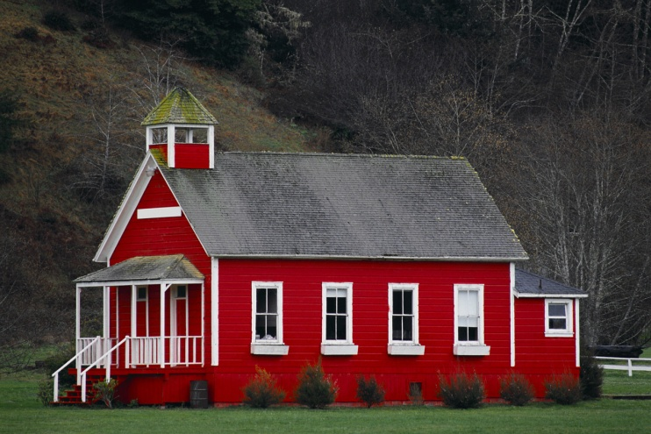
Design Space vs Actual Space
Design Space is the actual number of students the facility was designed for, when it was built.
Actual Space is the number of students that are actually in the facility.
Difference between the Design Space and Actual Space is the room (space) available.

Slide 24
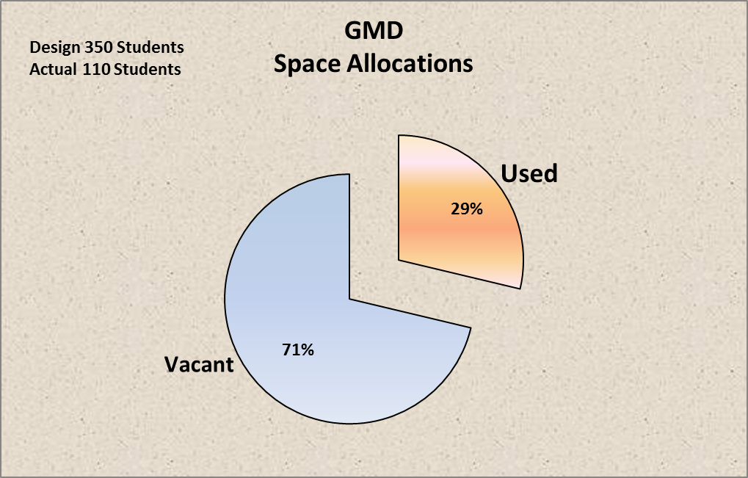
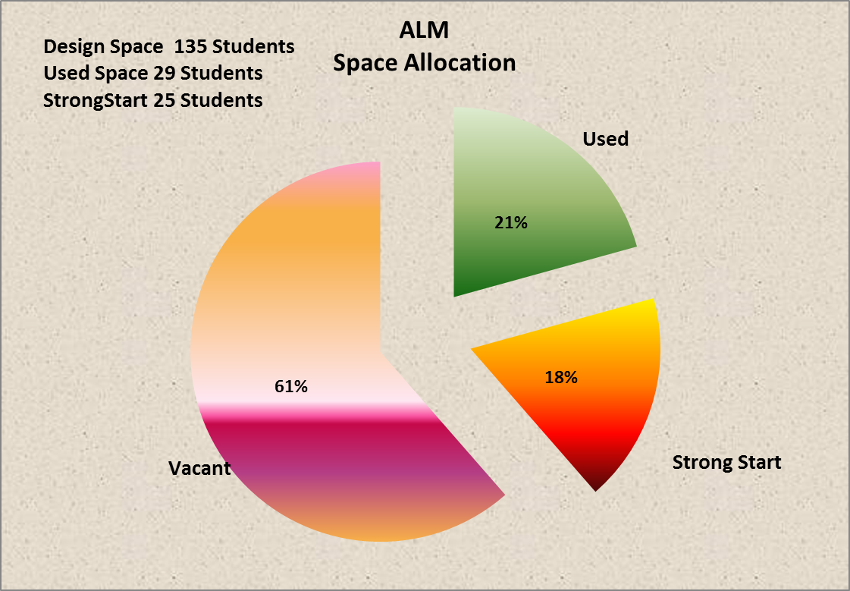
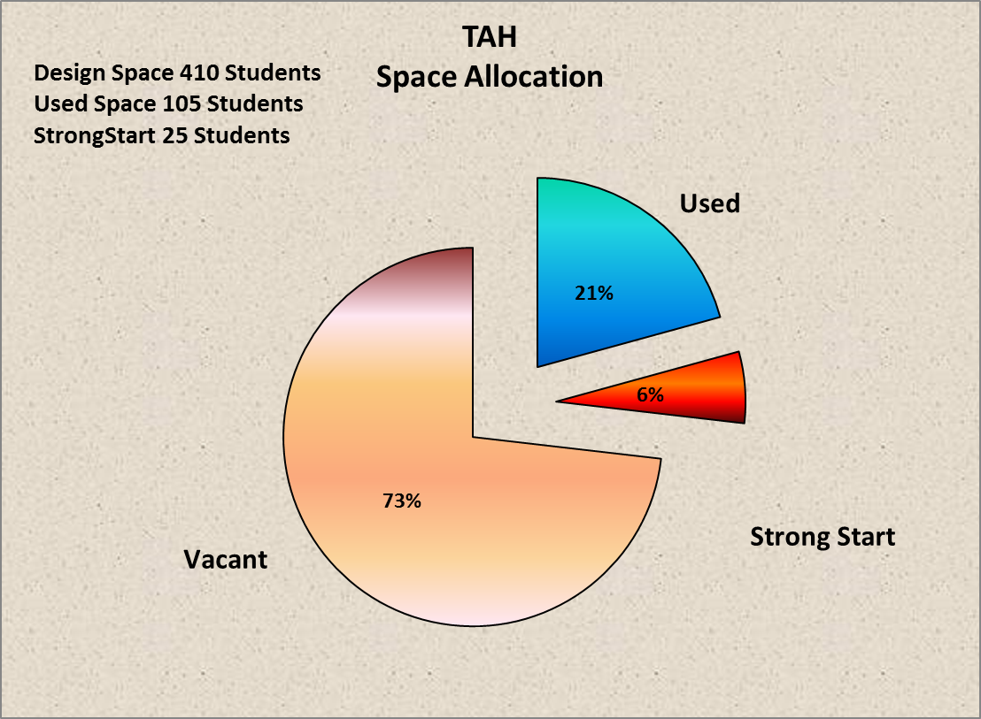
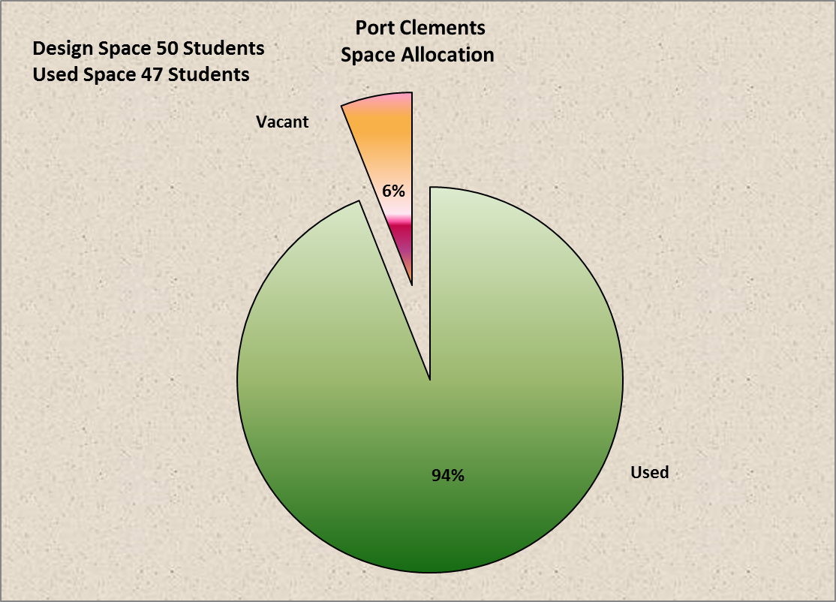

Slide 25
Questions and/or Comments

